Slide 1
Optimizing Trading Strategies with Reinforcement Learning
Amulya Saxena
Travis Desell

Slide 2
Agenda
Background
Related Work
Proposed Project and Approach
Conclusion

Slide 3
Background
Stock Market Fundamentals
DJI
Time Series Analysis
Reinforcement Learning
Notes:
Dow Jones Industrial Average (DJI): The DJI is one of the oldest and most widely recognized stock market indices in the world. It tracks the performance of 30 large, publicly-owned companies based in the United States, often referred to as "blue-chip" stocks. Understanding the composition, behavior, and historical performance of the DJI is crucial, as it provides insights into the broader market trends and economic health.
Reinforcement Learning (RL): RL is a type of machine learning where an agent learns to make decisions by performing actions and receiving feedback in the form of rewards or penalties. In the context of stock trading, the agent would make buy, hold, or sell decisions based on stock price data and receive rewards based on the profitability of those actions.
Stock Market Fundamentals: A solid understanding of stock market fundamentals, including how stocks are bought and sold, what influences stock prices (such as earnings reports, market sentiment, economic indicators), and basic financial metrics, is essential. This knowledge aids in interpreting model predictions and formulating effective trading strategies.
Time Series Analysis: Since stock prices are time series data, familiarity with time series analysis is crucial. This includes understanding concepts like trend, seasonality, and noise, as well as statistical models and techniques used to analyze time-dependent data sequences.

Slide 4
Related Work

Slide 5
Reference | Title | Area/Method
https://ssrn.com/abstract=3690996 | Deep Reinforcement Learning for Automated Stock Trading: An Ensemble Strategy | Reinforcement learning(RL)/Ensemble
http://hdl.handle.net/11250/2622891 | A Deep Reinforcement Learning Approach to Stock Trading | RL algorithms
https://doi.org/10.1016/j.knosys.2021.107119 | Technical analysis strategy optimization using a machine learning approach in stock market indices | Trading Strategies Optimization/ML
https://doi.org/10.17762/sfs.v10i2S.874 | Investment Strategies in Indian Stock Market Using Vader Algorithm Sentimental Analysis | Investment Strategies/Sentiment Analysis
https://doi.org/10.1016/j.eswa.2023.122801 | A novel Deep Reinforcement Learning based automated stock trading system using cascaded LSTM networks | RL/LSTM models

Slide 6
Trading Strategies
Hybrid models combine ml models with traditional trading signals, applied to major stock exchanges.
Evaluates various models like ANN, Random forests, SVR against metrics like MSE and RMSE, integrates trading strategies like EMA and measures outcomes with profit factor, number of trades, etc.
Hybrid models using linear models and ANNs outperforms conventional methods like TEMA in profitability and risk management.
Studies use VADER algorithm to assess sentiments of sensex stocks ranging over a decade, categorizing them in positive, negative or neutral based polarity scores for short term investment.
Notes:
Polarity scores are numerical values assigned by sentiment analysis algorithms to quantify the emotional valence of text data, indicating whether the expressed sentiment is positive, negative, or neutral. These scores are often normalized within a specific range, such as -1 to 1, where:
Positive values indicate positive sentiment, suggesting favorable opinions or feelings towards the subject matter.
Negative values reflect negative sentiment, indicating unfavorable opinions or adverse emotions associated with the content.
Values around zero typically represent neutral sentiment, meaning the text does not convey significant positive or negative emotions.
Sentiment analysis tools like VADER (Valence Aware Dictionary and sEntiment Reasoner)

Slide 7
Reinforcement learning
Studies use innovative ensemble trading strategies leveraging deep reinforcement learning.
Models like Cascaded LSTM are used to effectively mine hidden insights from data. Tested on major global indices. Benchmarked against models like buy and hold, multilayer perceptron policy and other models.
RL agents are trained on features extracted from LSTM models.
Experimental results show model outperforms baseline models and accuracy improvement rates range from 5% to 15%. This also indicates a promising way to build an automated trading system.
Notes:
We introduce a DRL-based stock trading system utilizing a Cascaded Long Short-Term Memory (CLSTM-PPO Model) to effectively mine hidden insights from daily stock data, addressing the common challenge of low signal-to-noise ratios in financial datasets.
The system is tested across major global indices—DJI, SSE50, SENSEX, and FTSE100— and is benchmarked against traditional and contemporary models, including buy-and-hold, MLP, and LGBM strategies, demonstrating superior performance in key financial metrics.
Our findings reveal enhancements in cumulative returns, maximum earning rates, and average trade profitability, with improvements ranging from 5% to 52%, showcasing the potential of our approach in revolutionizing automated stock trading systems.

Slide 8
Proposed Project and Approach

Slide 9
Proposed Project
Develop an agent to learn trading strategies for the DJI stocks leveraging reinforcement learning.
Create a system that can adapt to market changes and optimize strategic decisions in real time aiming to maximize returns.
Evaluate trading strategy performances using metrics and choose which the model will use.
Notes:
Metrics such as profit factor, number of trades, net profit, average profit per trade.

Slide 10
Approach
Semester 1 - Foundations
Literature Review and setting up framework
Conduct extensive review focusing on RL algorithms.
Define objectives and scope of the project.
EDA and Preprocessing
Feature Engineering
Finding financial indicators that will work best for modeling.
Initial Model development
Develop LSTM models, understand time series data patterns.
Run experiments with simple reinforcement models to establish a baseline.
Evaluation and Report

Slide 11
Approach – Semester 1
Extensive review
Setup framework
Statistical Analysis
Data Preprocessing
Creating new features
Finding financial indicators
Develop LSTM models
Run experiments
Establish Baseline
Literature Review
EDA
Feature Engineering
Model Development

Slide 12
Approach
Semester 2 – Advanced Model Development
Develop models for trading strategies
Simulate Trend following, momentum based and mean reversion strategies.
Integration with RL Agent
Let agent explore and learn from environments.
Model Selection and Testing
Comprehensive testing, fine tune parameters, optimize learning process.
Performance Evaluation
Evaluate results from semester 1 models and other models available in the same area of research.
Documentation and Presentation
Document the process, testing methodologies and results.
Prepare presentations and report findings.

Slide 13
Approach – Semester 2
Simulate trend following, momentum-based strategies.
Let Agent explore and learn in environments
Selecting and testing models
Performance Evaluation
Document process, results
Present findings
Develop models
RL integration
Model Testing and Evaluation
Documentation

Slide 14
Agenda
Overview
Domain Model
Architecture Model
Github and Demo

Slide 15
Overview

Slide 16
Optimizing + Reinforcement Learning
What it is : RL + Time Series Forecasting
Goals
Enhanced Forecasting
Trading Decisions
Increase Profitability
Notes:
The project aims to tackle the challenges of forecasting stock market returns in the complex and volatile environment of the DJI. Recognizing the limitations of traditional trading models in capturing the multifaceted dynamics of financial markets, the research seeks to employ Reinforcement Learning (RL)
RL’s capacity to learn and adapt through interaction with an environment makes it suitable for understanding and anticipating market behavior, which is influenced by economic indicators, geopolitical events, and rapid technological advances. Over time, the RL agent would refine its trading strategy to maximize the cumulative reward
The RL agent would ingest market data, which may include price, volume, and possibly technical indicators or sentiment analysis from news articles. It would use this data to understand the current state of the market.
Based on its analysis and the state it has constructed from the data, the RL agent would make trading decisions, such as whether to buy, sell, or hold a particular stock.
The RL agent would utilize a reward function to evaluate the effectiveness of its actions
- Enhanced Forecasting: To provide a more sophisticated tool for predicting stock market returns that can handle the complexities and volatile nature of modern financial markets.
- Informed Trading Decisions: To enable investors to make more informed decisions by employing adaptive trading methods that respond to real-time market conditions.
- Increased Profitability: To aid investors and financial institutions in improving their profitability and portfolio management through optimized trading strategies.

Slide 17
Domain Model

Slide 18
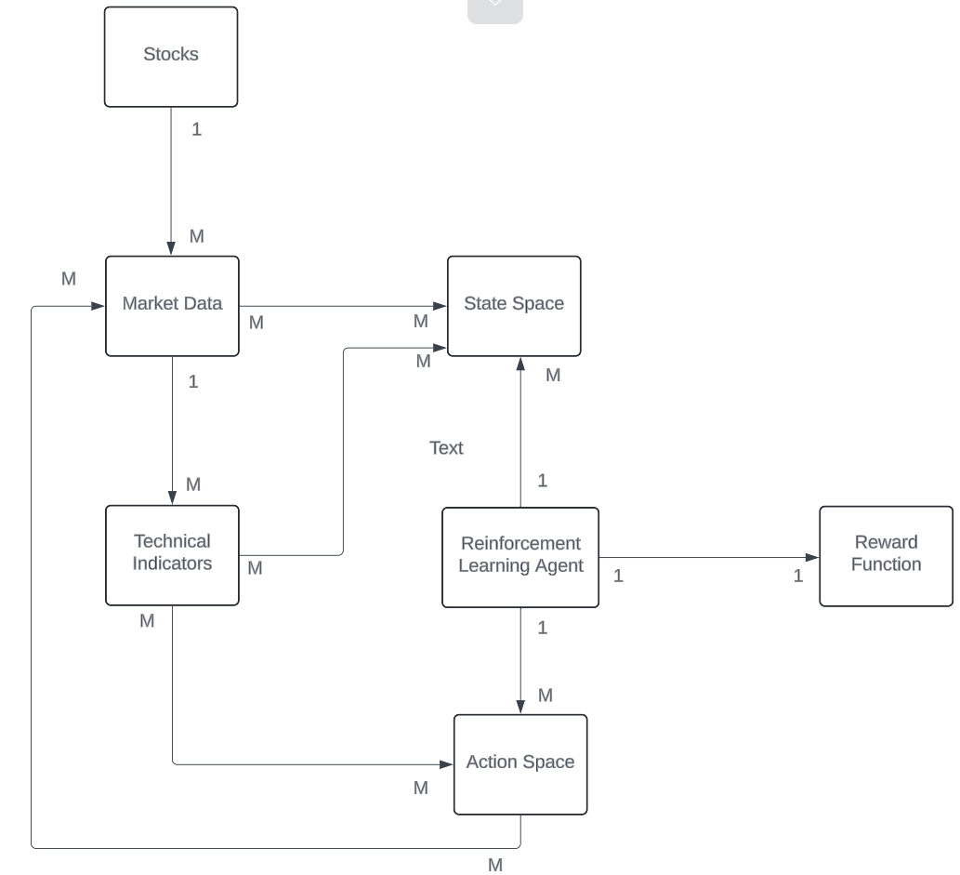

Slide 19
Architecture Model

Slide 20
Data Foundations
Data Ingestion
Data Preprocessing and Feature Engineering
Database

Slide 21
Intelligence Core
Machine / Deep Learning Baseline Models
RL Agent
Algorithms
Notes:
Machine/Deep Learning:
Utilizes advanced algorithms for predictive modeling.
Adapts to market dynamics and learns from new data.
Continuous improvement of models for better accuracy.
RL Agent:
Processes historical and real-time data to make data-driven trading decisions.
Learns optimal actions by maximizing the reward function.
Simulates various trading strategies to identify the most effective ones.
Algorithms:
Optimization of trading strategies based on machine learning insights.
Designing trading signals that capture market opportunities.
Rigorous backtesting to validate strategies before live-market execution.

Slide 22
User Interface
User Interface
Feedback Loop
Testing and Documentation
Notes:
User Interface:
Will have a interactive dashboard for visualization.
Real-time display of market analytics and different types of strategies to try out
Feedback Loop:
takes user feedback and adjustments for system refinement.
Allows for customizations and preferences in the trading strategy.
Feedback will be used to fine-tune models and improve future predictions.
Presents analyzed data and insights in an accessible format.
Delivers clear trading signals for user execution.
Facilitates evaluation of the system’s performance and strategy effectiveness.

Slide 23
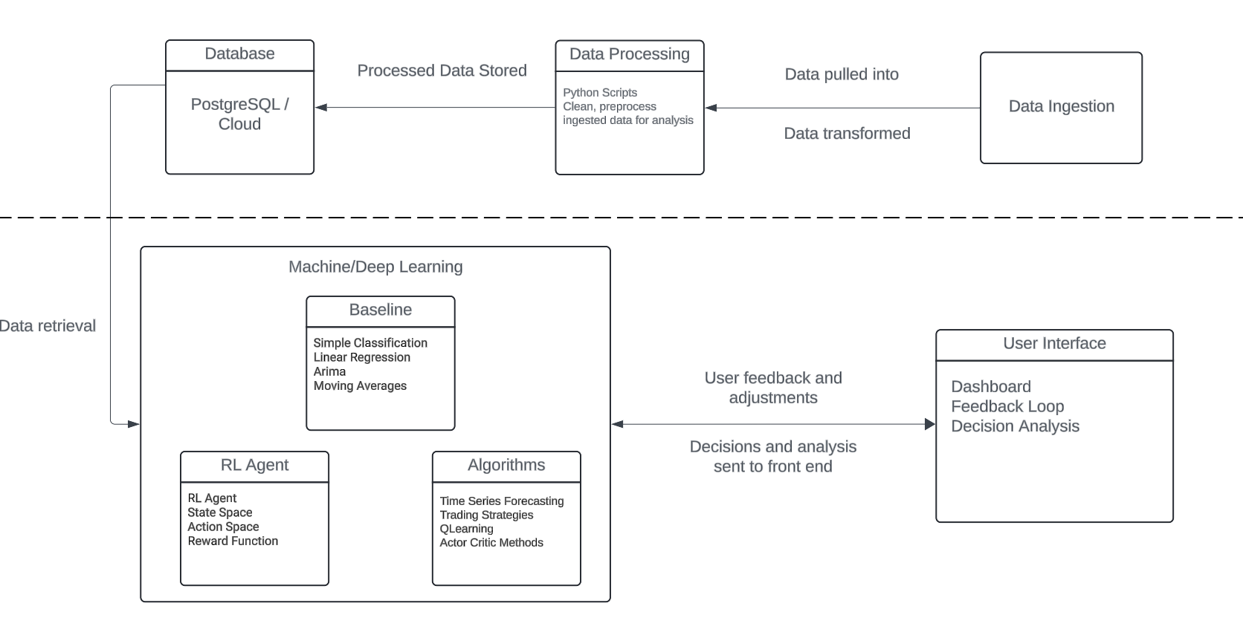

Slide 24
GitHub and Demo

Slide 25
Pending Architecture
Database Configuration
RL Agent and Algorithms
User Interface
Feedback Loop
Documentation
Notes:
Database config :
Based on system requirements, choose a relational database like PostgreSQL for structured data or a NoSQL database if unstructured or semi-structured data is also involved.
Server Config - Determine if the database will be hosted on-premises or in the cloud. Set up and configure the necessary servers or cloud services.
Storage planning
Memory and Compute resources
RL Agent: A core component of the system, the RL agent, uses the processed data to make decisions. It learns from historical data to make predictions and take actions that maximize some notion of cumulative financial reward.
Algorithms: This involves not just the RL algorithms but also potentially other algorithms for optimizing trading strategies and generating trading signals.
User Interface: Through a dashboard, users can interact with the system, view visualizations of market data and model outputs, and receive decision support for trades.

Slide 26
Thank you

